Slide 1
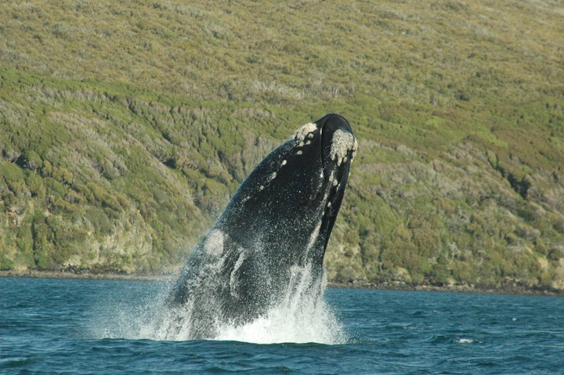
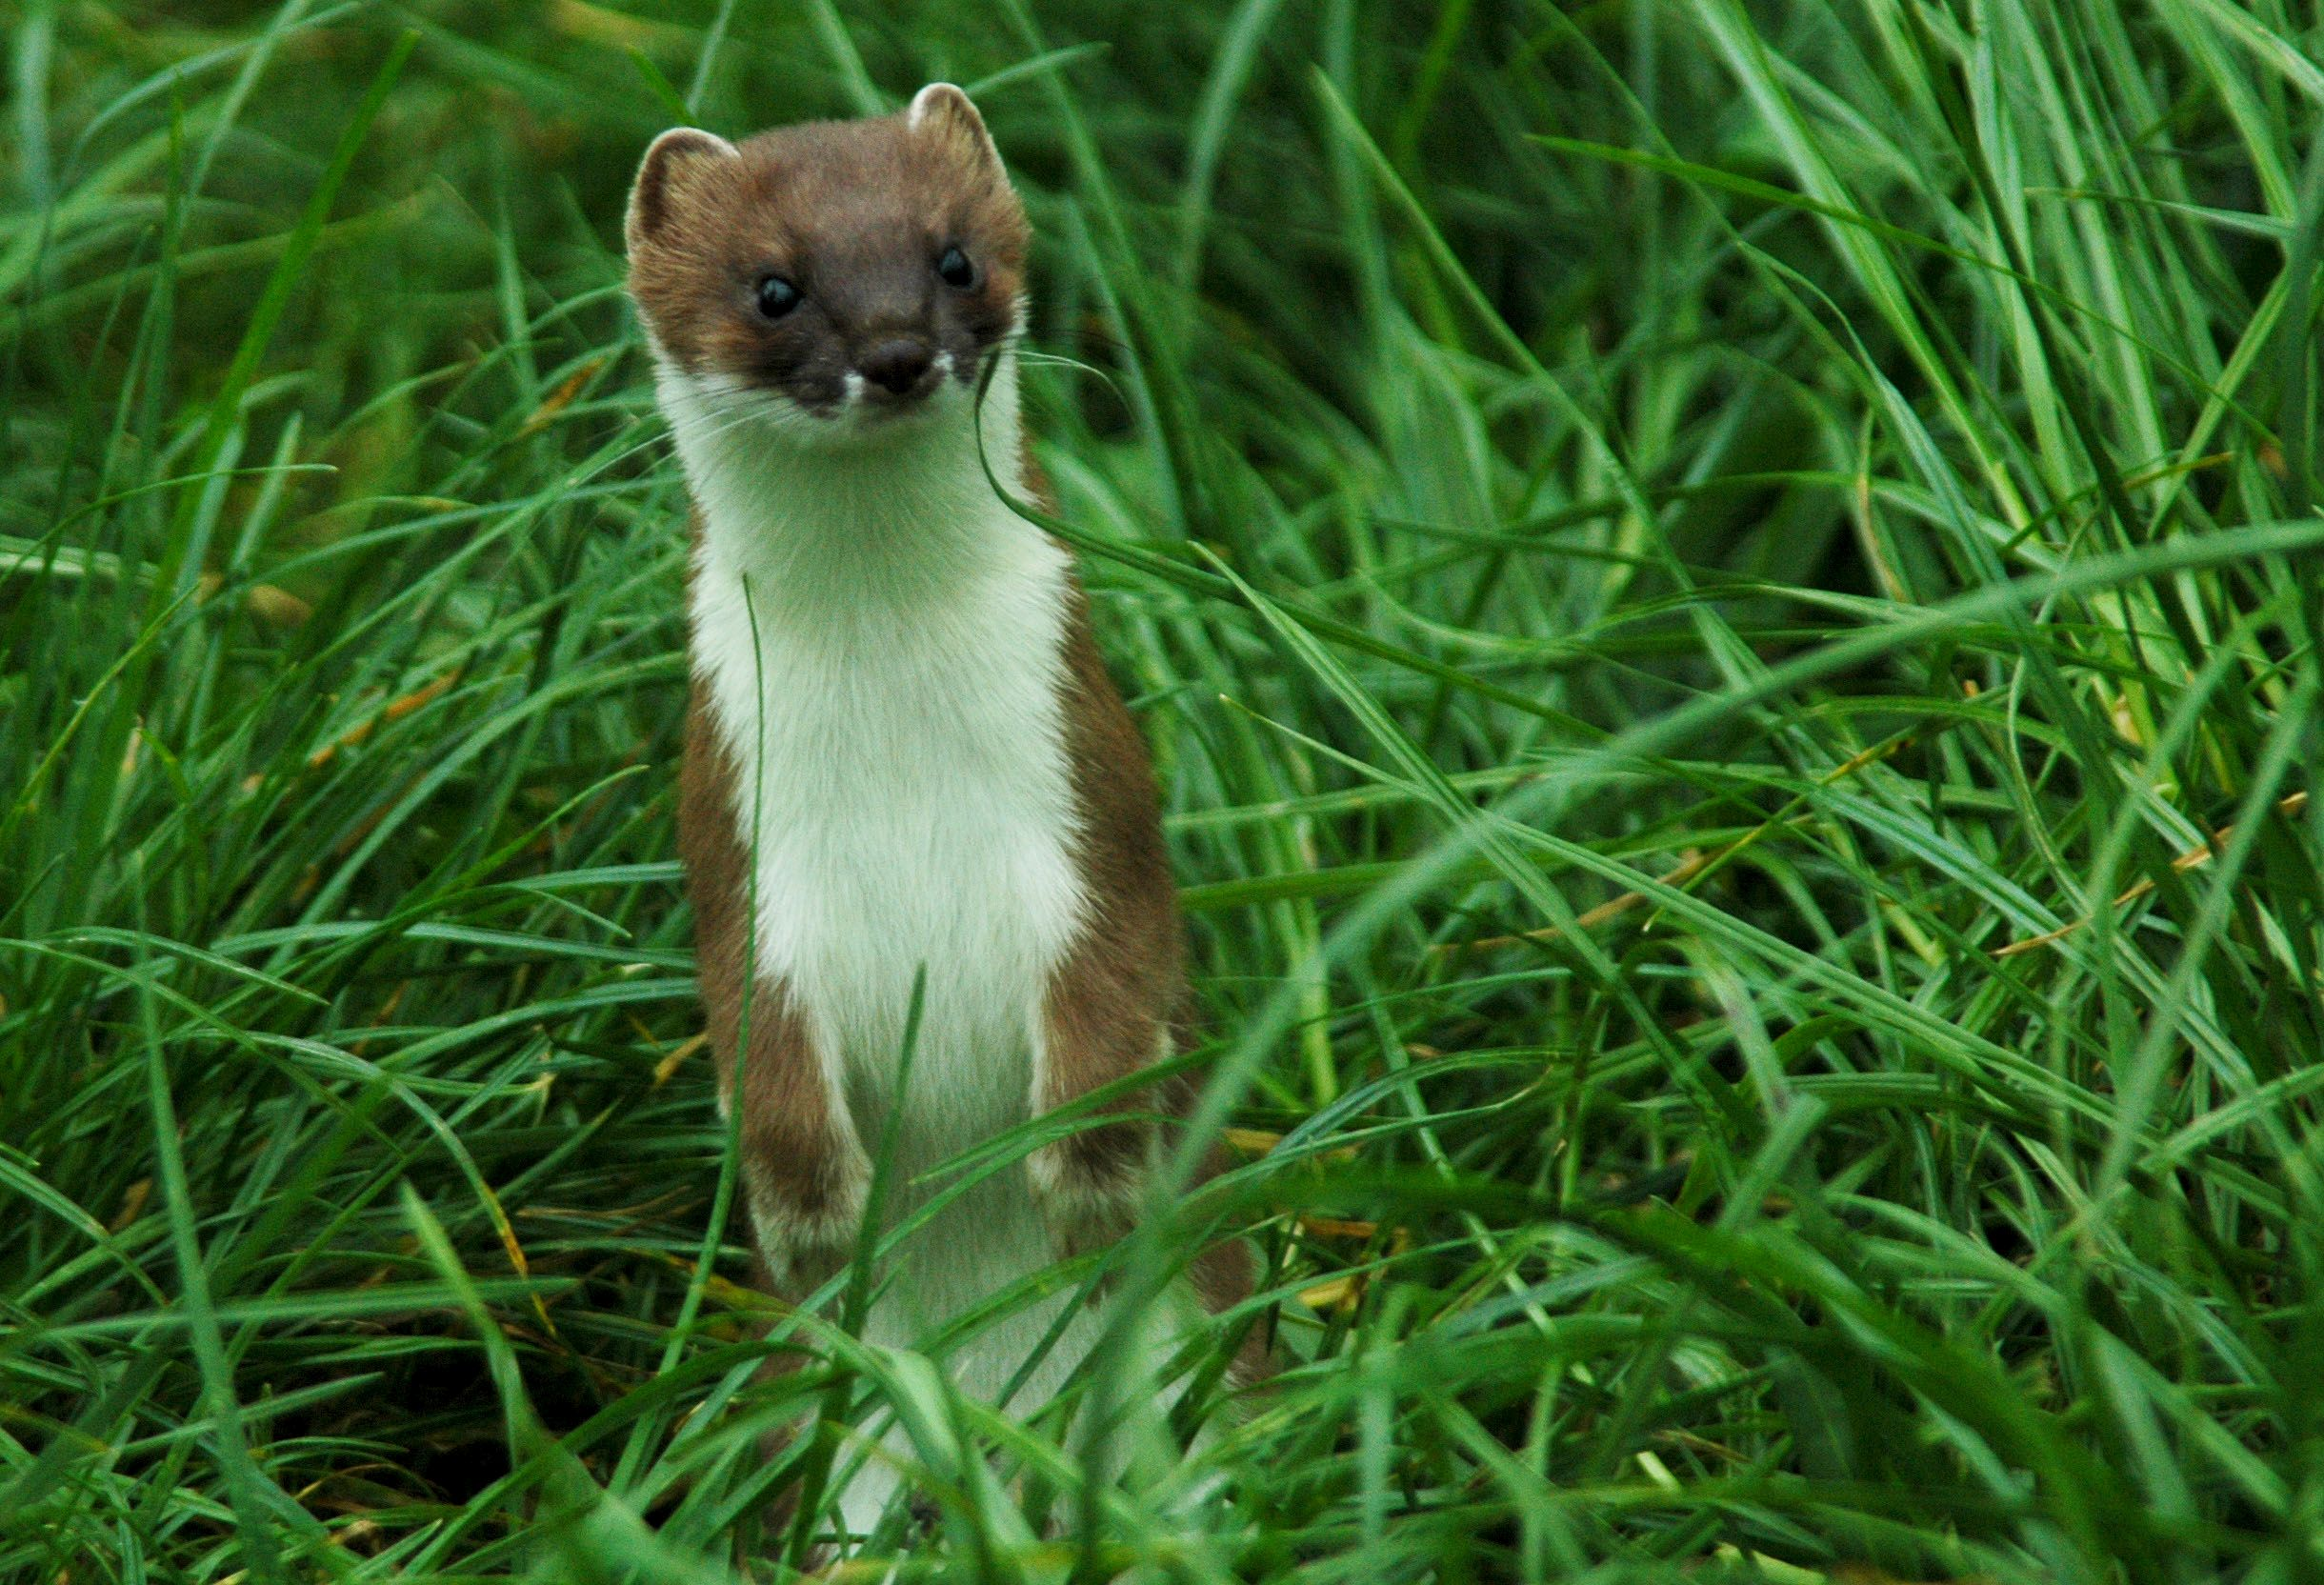
From whales to mice
Notes:
My name is Anthony Davidson and I am really excited to talk to everyone today about some of the work that I have done at Otago and how this has lead to working with forest systems at the University of Canberra.
I think these two photos are great to explain my current knowledge…..obviously the stoat is not a mouse.....but sometimes when we get so involved in the modelling we forget what species we are even looking at...well me anyways. This could be the main reason I am here now.

Slide 2
Outline
Southern right whales
Dave Choquent scholarship
PhD under Australian standards
Unexpected results of pest control
Three datasets
Stoats, Mice and Rats
Observation/Process model
Example
Notes:
So this is the layout of todays talk….

Slide 3
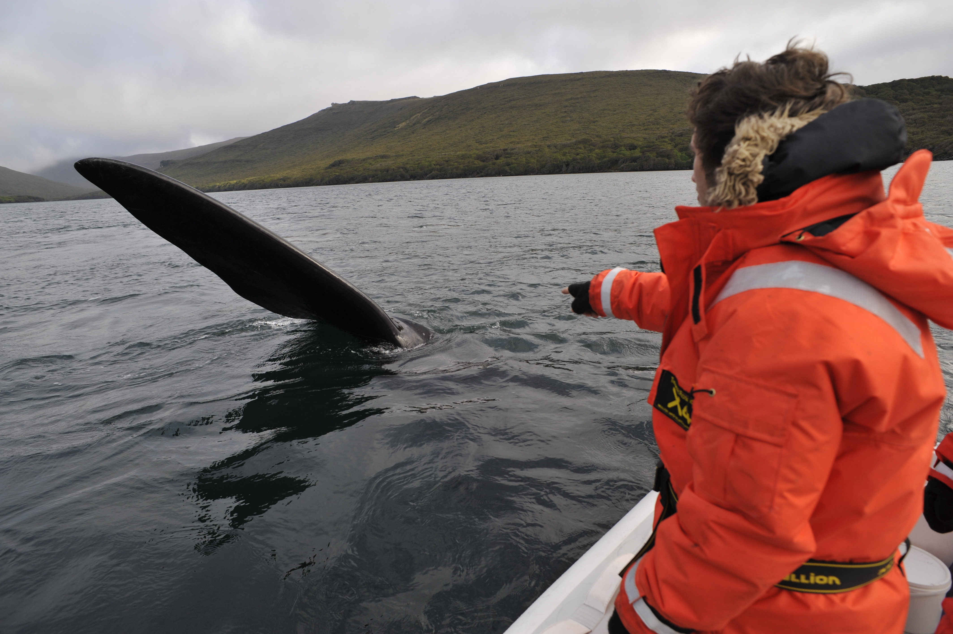
A rookie…

Slide 4
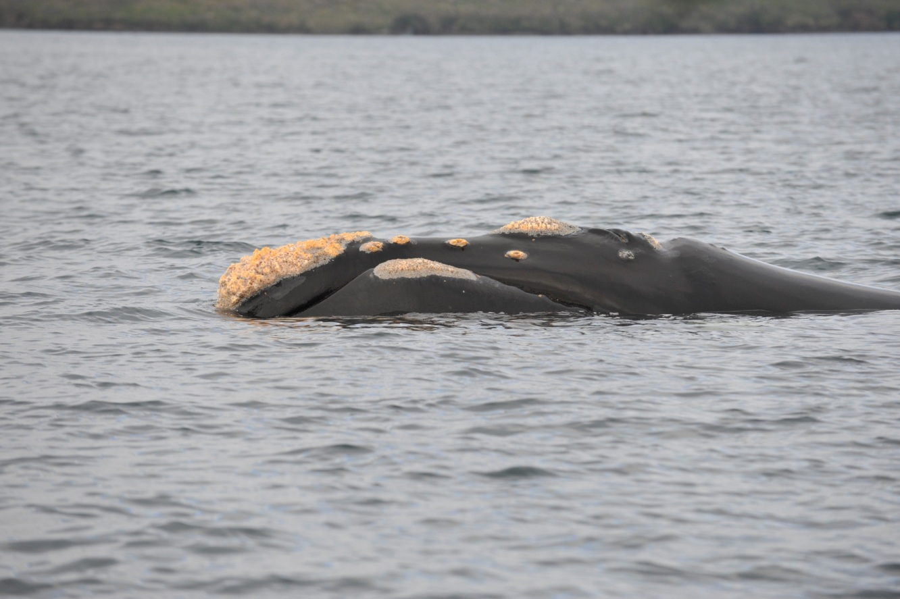
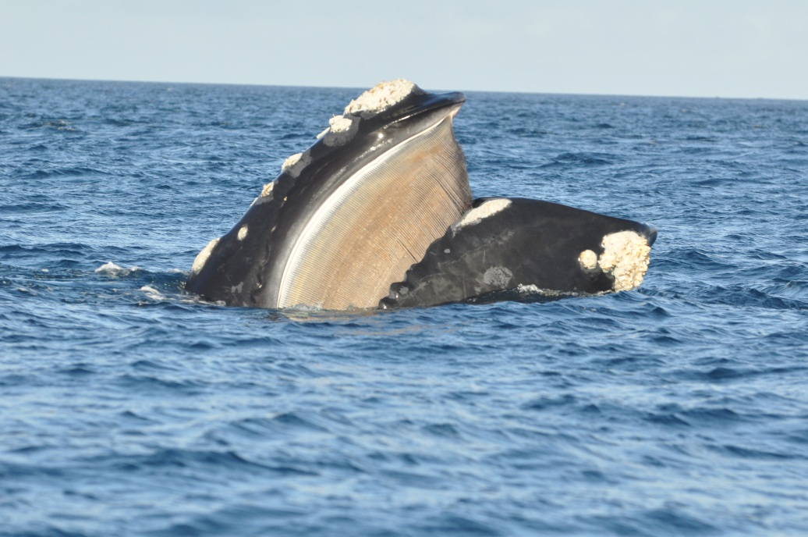
New Zealand southern right whale
Hunted to near extinction
Thought to be increasing 5% (95% CI -2%-13%)
Current abundance 1074 (95% CI 812-1339)
High site fidelity
All mature individuals are uniquely identifiable
© Steve Dawson
© Anthony Davidson
© Will Rayment
Notes:
Baleen relate to picture
Most of this because of coastal environment they migrate to and from. Calve and have sex in winter on the calving grounds
By 19th century hunted to commercial extinction because the Right whale to hunt
Protected since 1935
Soviet exploitation in the 1960’s (Tormosov et al 1998) 1951-1971
Our species now not many other stresses
But NARW entanglement, ship strike and pollution
3 main stocks of SRW:
South Africa
South Australia
Argentina
New Zealand
Remnant population of Mainland New Zealand stock (Carroll et al 2011) Biopsy and photo ID assessment
Also home to sea lions, penguins etc
Wildlife is very relaxed as not much human contact

Slide 5
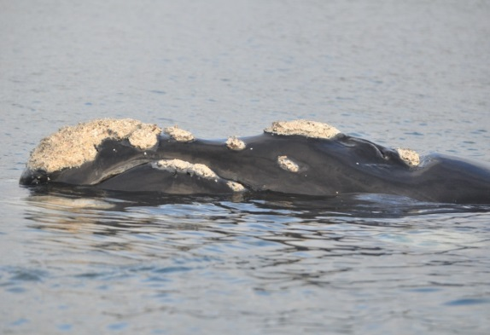
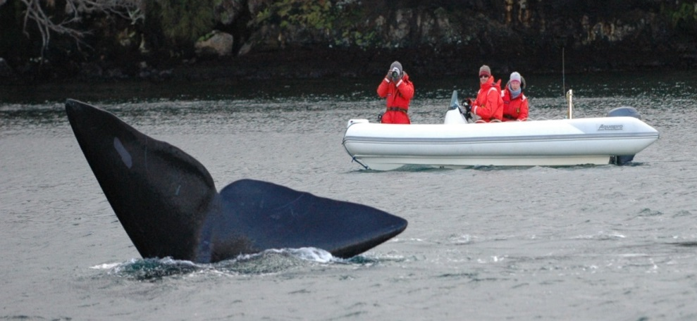
Data collection

Slide 6
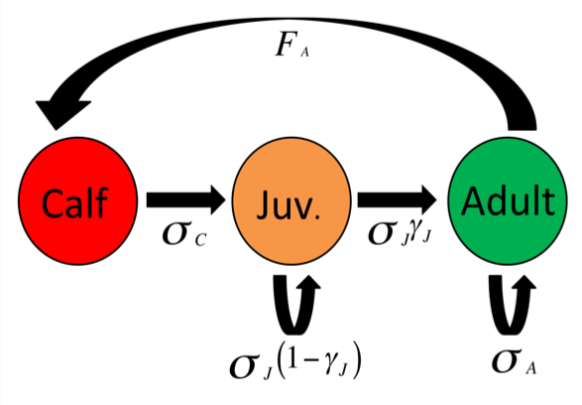
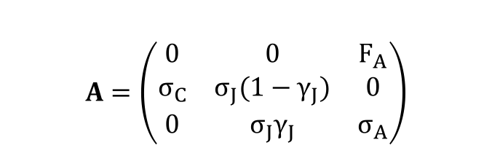
Life cycle diagram
$$A=\left(\begin{matrix}0 & 0 & F_{A} \\ σ_{C} & σ_{J}{(1−γ}_{J}) & 0 \\ 0 & σ_{J}γ_{J} & σ_{A}\end{matrix}\right)$$
Notes:
Calf is one year – asymptotic growth is over 75% in first year so survival thought to increase after first year
Juv. Is effected by stage length
Adults don’t go anywhere
Reproduction includes adult survival
Had a section on how each of these parameters are chosen and estimated but don’t have time. Feel free to talk to me after about these
The mathematics here that allow for this are probably not going to interest many people here but it is cool

Slide 7
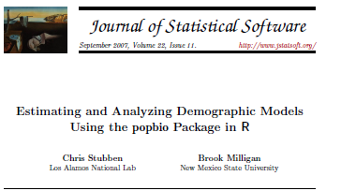
R package POPBIO
Notes:
Reason that I have not gone into much detail about maths
Take matrix and use this package
Examples from Caswell 2001 and Doak 2002
CONTENTS OF POPBIO
01.Introduction . . . . . . . . . . . . . . . . . . . . . . . . . . . . . . . . . . . . . . . 3
02.Caswell . . . . . . . . . . . . . . . . . . . . . . . . . . . . . . . . . . . . . . . . . 3
03.Morris . . . . . . . . . . . . . . . . . . . . . . . . . . . . . . . . . . . . . . . . . . 5
aq.census . . . . . . . . . . . . . . . . . . . . . . . . . . . . . . . . . . . . . . . . . . 6
aq.matrix . . . . . . . . . . . . . . . . . . . . . . . . . . . . . . . . . . . . . . . . . . 7
aq.trans . . . . . . . . . . . . . . . . . . . . . . . . . . . . . . . . . . . . . . . . . . . 8
betaval . . . . . . . . . . . . . . . . . . . . . . . . . . . . . . . . . . . . . . . . . . . . 10
boot.transitions . . . . . . . . . . . . . . . . . . . . . . . . . . . . . . . . . . . . . . . 11
calathea . . . . . . . . . . . . . . . . . . . . . . . . . . . . . . . . . . . . . . . . . . . 13
countCDFxt . . . . . . . . . . . . . . . . . . . . . . . . . . . . . . . . . . . . . . . . . 15
damping.ratio . . . . . . . . . . . . . . . . . . . . . . . . . . . . . . . . . . . . . . . . 16
eigen.analysis . . . . . . . . . . . . . . . . . . . . . . . . . . . . . . . . . . . . . . . . 17
elasticity . . . . . . . . . . . . . . . . . . . . . . . . . . . . . . . . . . . . . . . . . . . 19
extCDF . . . . . . . . . . . . . . . . . . . . . . . . . . . . . . . . . . . . . . . . . . . 20
fundamental.matrix . . . . . . . . . . . . . . . . . . . . . . . . . . . . . . . . . . . . . 22
12 R topics documented:
generation.time . . . . . . . . . . . . . . . . . . . . . . . . . . . . . . . . . . . . . . . 23
grizzly . . . . . . . . . . . . . . . . . . . . . . . . . . . . . . . . . . . . . . . . . . . . 24
head2 . . . . . . . . . . . . . . . . . . . . . . . . . . . . . . . . . . . . . . . . . . . . 25
hudcorrs . . . . . . . . . . . . . . . . . . . . . . . . . . . . . . . . . . . . . . . . . . . 26
hudmxdef . . . . . . . . . . . . . . . . . . . . . . . . . . . . . . . . . . . . . . . . . . 27
hudsonia . . . . . . . . . . . . . . . . . . . . . . . . . . . . . . . . . . . . . . . . . . . 28
hudvrs . . . . . . . . . . . . . . . . . . . . . . . . . . . . . . . . . . . . . . . . . . . . 29
image2 . . . . . . . . . . . . . . . . . . . . . . . . . . . . . . . . . . . . . . . . . . . . 29
Kendall . . . . . . . . . . . . . . . . . . . . . . . . . . . . . . . . . . . . . . . . . . . 31
lambda . . . . . . . . . . . . . . . . . . . . . . . . . . . . . . . . . . . . . . . . . . . . 33
lnorms . . . . . . . . . . . . . . . . . . . . . . . . . . . . . . . . . . . . . . . . . . . . 34
logi.hist.plot . . . . . . . . . . . . . . . . . . . . . . . . . . . . . . . . . . . . . . . . . 35
LTRE . . . . . . . . . . . . . . . . . . . . . . . . . . . . . . . . . . . . . . . . . . . . 37
matplot2 . . . . . . . . . . . . . . . . . . . . . . . . . . . . . . . . . . . . . . . . . . . 39
matrix2 . . . . . . . . . . . . . . . . . . . . . . . . . . . . . . . . . . . . . . . . . . . 41
mean.list . . . . . . . . . . . . . . . . . . . . . . . . . . . . . . . . . . . . . . . . . . . 42
monkeyflower . . . . . . . . . . . . . . . . . . . . . . . . . . . . . . . . . . . . . . . . 43
multiresultm . . . . . . . . . . . . . . . . . . . . . . . . . . . . . . . . . . . . . . . . . 44
nematode . . . . . . . . . . . . . . . . . . . . . . . . . . . . . . . . . . . . . . . . . . 46
net.reproductive.rate . . . . . . . . . . . . . . . . . . . . . . . . . . . . . . . . . . . . 47
pfister.plot . . . . . . . . . . . . . . . . . . . . . . . . . . . . . . . . . . . . . . . . . . 48
pop.projection . . . . . . . . . . . . . . . . . . . . . . . . . . . . . . . . . . . . . . . . 49
projection.matrix . . . . . . . . . . . . . . . . . . . . . . . . . . . . . . . . . . . . . . 51
QPmat . . . . . . . . . . . . . . . . . . . . . . . . . . . . . . . . . . . . . . . . . . . . 53
reproductive.value . . . . . . . . . . . . . . . . . . . . . . . . . . . . . . . . . . . . . . 54
resample . . . . . . . . . . . . . . . . . . . . . . . . . . . . . . . . . . . . . . . . . . . 55
secder . . . . . . . . . . . . . . . . . . . . . . . . . . . . . . . . . . . . . . . . . . . . 57
sensitivity . . . . . . . . . . . . . . . . . . . . . . . . . . . . . . . . . . . . . . . . . . 58
splitA . . . . . . . . . . . . . . . . . . . . . . . . . . . . . . . . . . . . . . . . . . . . 60
stable.stage . . . . . . . . . . . . . . . . . . . . . . . . . . . . . . . . . . . . . . . . . 61
stage.vector.plot . . . . . . . . . . . . . . . . . . . . . . . . . . . . . . . . . . . . . . . 62
stoch.growth.rate . . . . . . . . . . . . . . . . . . . . . . . . . . . . . . . . . . . . . . 63
stoch.projection . . . . . . . . . . . . . . . . . . . . . . . . . . . . . . . . . . . . . . . 64
stoch.quasi.ext . . . . . . . . . . . . . . . . . . . . . . . . . . . . . . . . . . . . . . . . 66
stoch.sens . . . . . . . . . . . . . . . . . . . . . . . . . . . . . . . . . . . . . . . . . . 67
stretchbetaval . . . . . . . . . . . . . . . . . . . . . . . . . . . . . . . . . . . . . . . . 68
teasel . . . . . . . . . . . . . . . . . . . . . . . . . . . . . . . . . . . . . . . . . . . . 70
test.census . . . . . . . . . . . . . . . . . . . . . . . . . . . . . . . . . . . . . . . . . . 71
tortoise . . . . . . . . . . . . . . . . . . . . . . . . . . . . . . . . . . . . . . . . . . . 72
var2 . . . . . . . . . . . . . . . . . . . . . . . . . . . . . . . . . . . . . . . . . . . . . 73
varEst . . . . . . . . . . . . . . . . . . . . . . . . . . . . . . . . . . . . . . . . . . . . 74
vitalsens . . . . . . . . . . . . . . . . . . . . . . . . . . . . . . . . . . . . . . . . . . . 75
vitalsim . . . . . . . . . . . . . . . . . . . . . . . . . . . . . . . . . . . . . . . . . . . 77
whale . . . . . . . . . . . . . . . . . . . . . . . . . . . . . . . . . . . . . . . . . . . . 79
woodpecker . . . . . . . . . . . . . . . . . . . . . . . . . . . . . . . . . . . . . . . . . 80

Slide 8
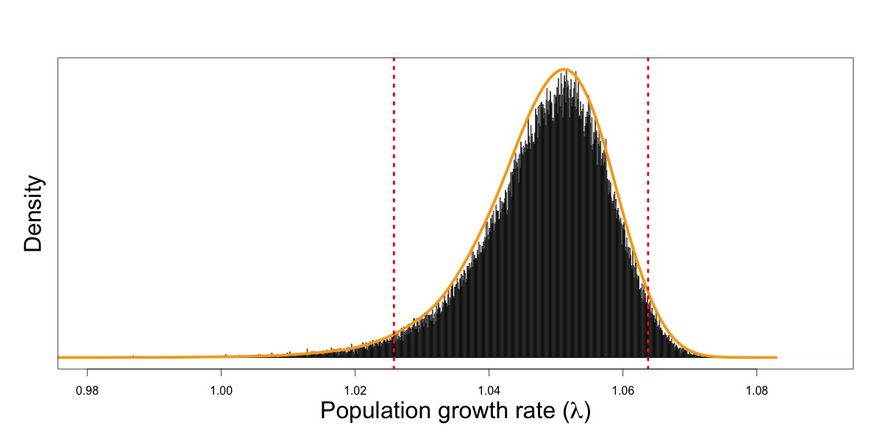
Results continued…
The uncertainty around the mean can be used to estimate a distribution for the current population growth rate.
The population growth rate = 5% (2.6% to 6.4%)
Notes:
5% per year and 95% CI 2.6% to 6.4%
Generate by hand or popbio CI put out
Uncertainty not year to year variability?!?!
Further step by hand

Slide 9
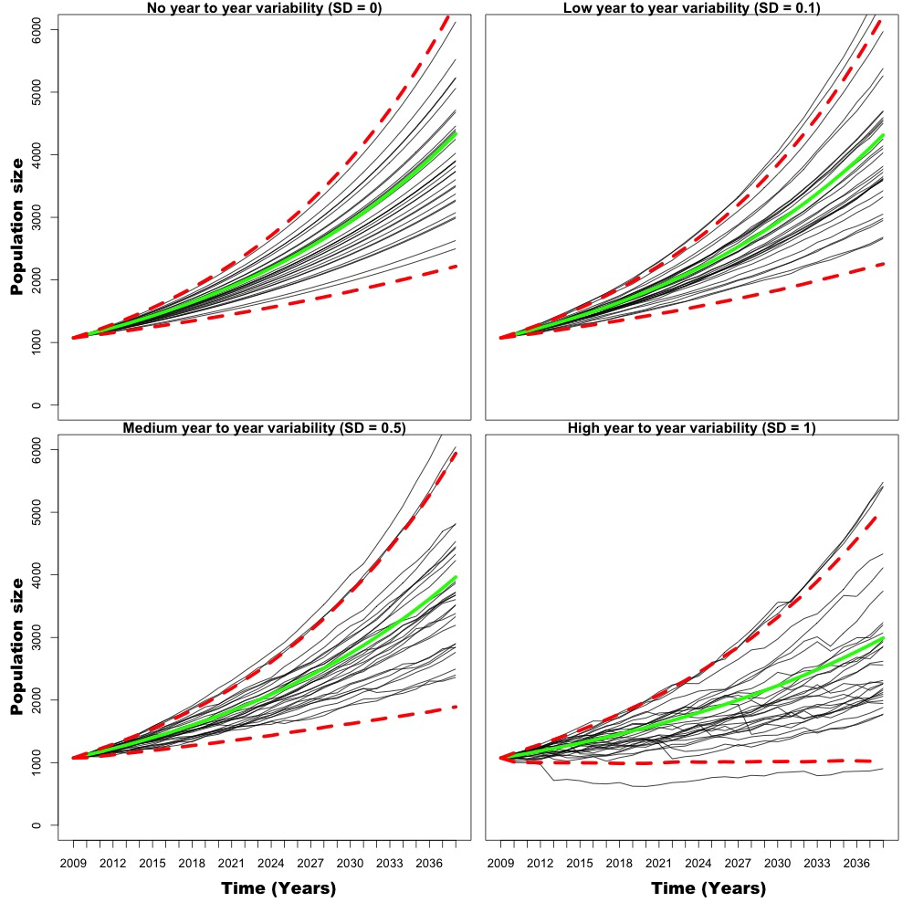
Adding year-to-year stochasticity
Notes:
30 year projection
Increase in uncertainty as environmental variability increases
Cant estimate this without long-term mark-recapture and complex bayesian models (process and observation error needs splitting up)

Slide 10
With all good research should come more questions?
We had an issue separating process and observation error
This is the error associated with

Slide 11
Dave Choqouet scholarship
Notes:
And once I accepted this I actually worked out it wasn’t ANU….
But Canberra has some amazing attributes for ecological research

Slide 12
University of Canberra

Slide 13

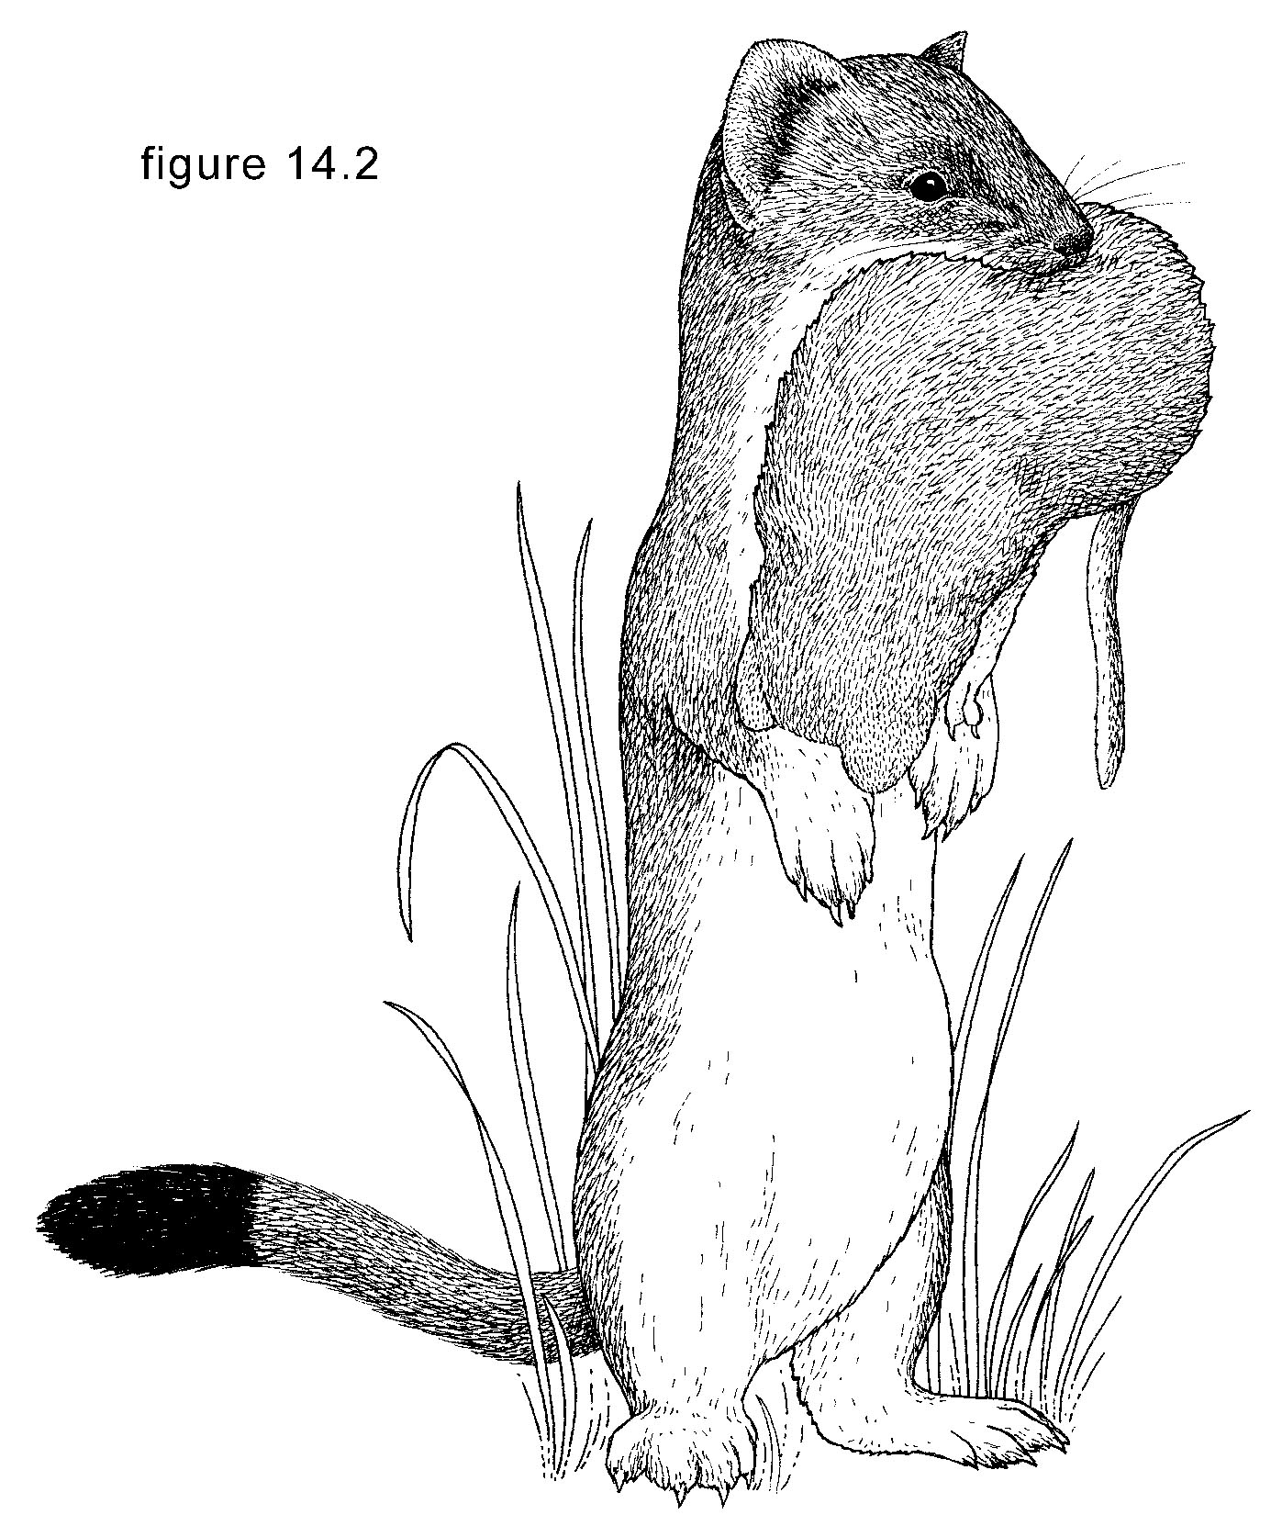
Bayesian
hierarchical models to evaluate species interactions – New Zealand forest systems
Anthony Davidson
Supervisors:
Richard Duncan
Bernd Gruber
Wendy Ruscoe
Roger Pech
Consie Powell

Slide 14
The rest of the talk
Simple species interactions
New Zealand species
Complex species interaction
PhD Aims
Case Study One: Beech forest dynamics
PhD timeline
Budget

Slide 15
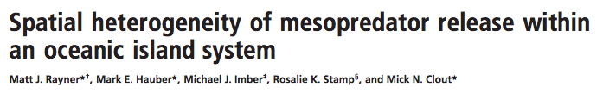
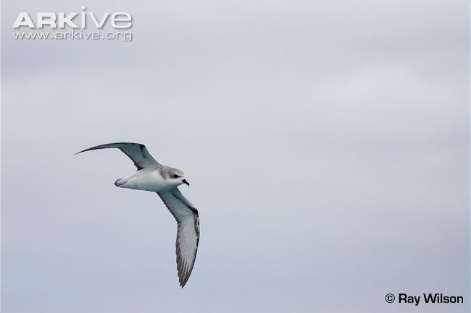
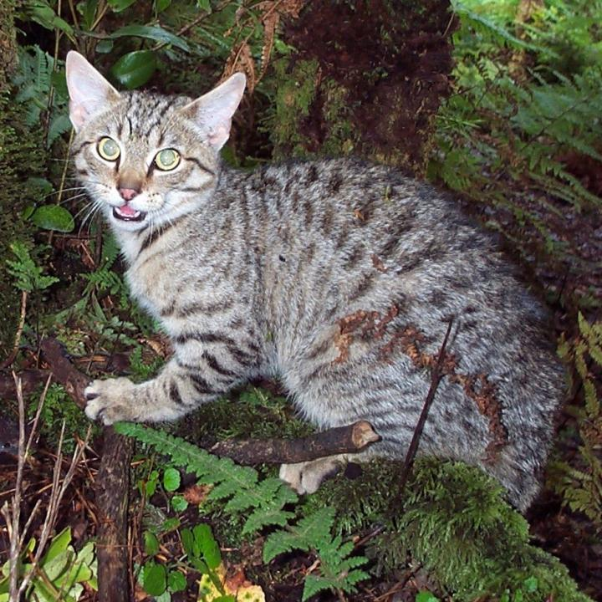
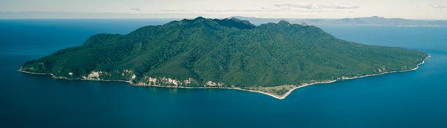
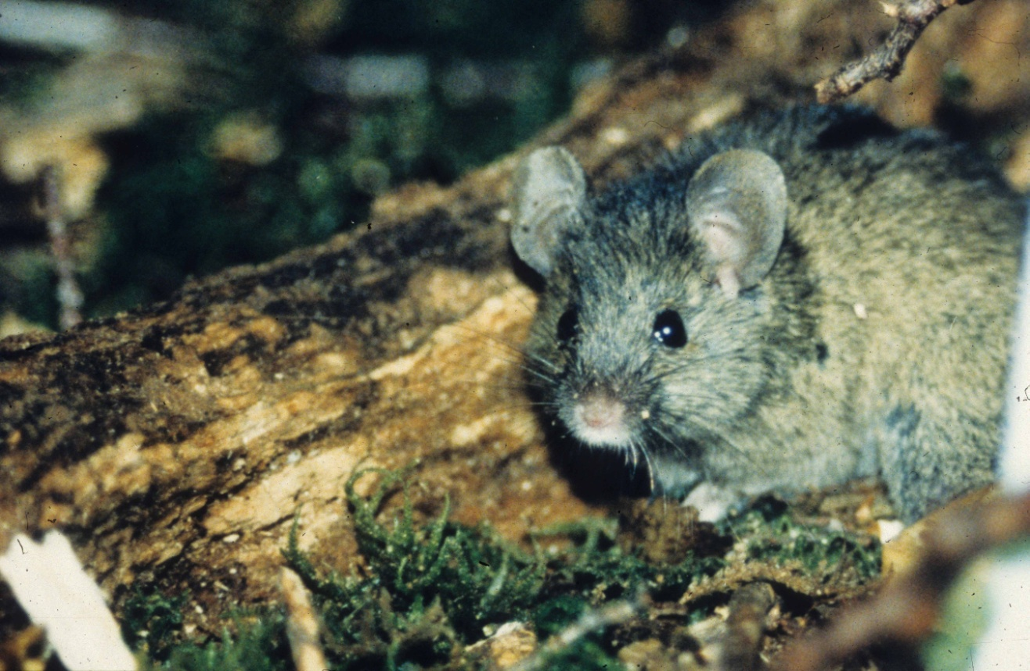
A conservation
Cook’s petrel (Pterodroma cookii)
Wild cat
Little Barrier Island, New Zealand
C M King
Mice
Notes:
Rayner et al 2007:
Investigated mesopredator release on Little Barrier Island (80kms north of Auckland, SIZE: 28km2)
Has largest cooks petrel colony by a long way (50 000+ pairs (2003))
Waikato is extinct
Great Barrier island decreasing (2003), codfish Island increasing (2003)
Looks at cats, rats and seabird (Cooks Petrel)
Cooks petrel is one of the smallest petrels
Restricted to pacific ocean
Only breeds on 3 islands in nz (little barrier, great barrier, codfish)
oct-may (summer breeding
Pop estimate = 125800 and declining
IUCN listing = vulnerable
Prefers hills <1000m + 20-30 km inland

Slide 16



Prior to 1980
Feral cat
Cook’s petrel
Pacific rat
Notes:
They had monitoring data from 1971-2007 of petrel burrows before during and after nesting.
Looked at breeding success. = number of study burrows with fledglings
However issues like landslides on the alpine colony (lost all but 15 burrows) sounded interesting
Intensive study between 1972-1974.
Cats were eating seabirds so they eradicated them
Eradication 1980.

Slide 17
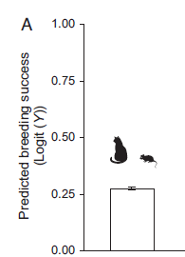
Prior to 1980
Prior to 1980
Rayner et al. (2007) PNAS 104: 20862-20865
Notes:
Very low compared to other burrowing seabirds (70-80% burrow success on very brief search)

Slide 18
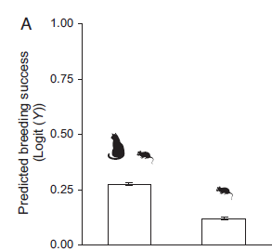
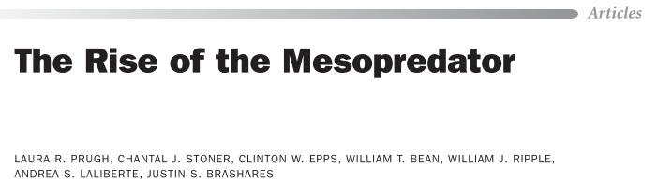
After 1980 (cat eradication)
Prior to 1980
1981 - 2004
Rayner et al. (2007) PNAS 104: 20862-20865
Notes:
Breeding success of Cook petrels declined even more after the removal of cats

Slide 19
After 1980 (cat eradication)
Unexpected (and undesired) consequence of controlling an invasive top predator
Feral cat
Cook’s petrel
Mesopredator release
Pacific rat
Notes:
2003 publication on Cook’s petrel described the Little barrier Island as “Unstable” in a 2003 publication (Imber et al 2003).
At that time they where probably bang on.

Slide 20
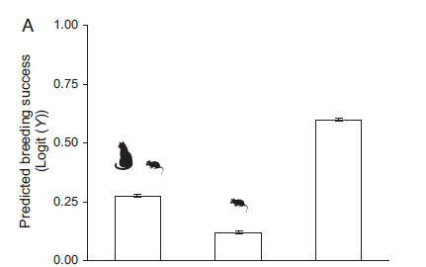
After 2004 (rat eradication)
Prior to 1980
1981 - 2004
After 2004
Rayner et al. (2007) PNAS 104: 20862-20865
Notes:
2004 1080 drop for rats
2006 post eradication monitoring confirmed no introduced mammals on little barrier
Interestingly I’m not sure how low that breeding rate might be compared to other populations??

Slide 21
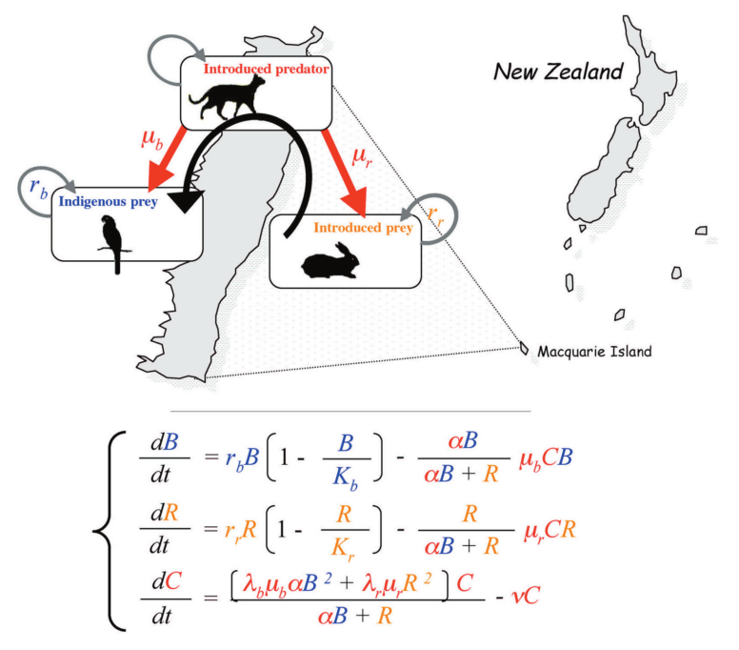
Mathematics behind the diagram (e.g.)
Courchamp and Caut (2006). Use of biological invasions and their control to study the dynamics of interacting populations.
Notes:
This is from a book chapter that is representing the same model as described by Courchamp et al 2000 on hyperpredation
Mine just doesn’t look as nice yet

Slide 22


Predator release
Target species reduction (e.g pest control)
Predator
Secondary species increases
Prey
Notes:
Cats and Kiwi bird.
Standard hope for outcome from pest control. Many programs assume that this relationship will happen.
They do this by recording the success of a pest program as the percentage of pests still present after eradication.
And they are doing conservation (with the overall goal of conserving species (not removing them).

Slide 23


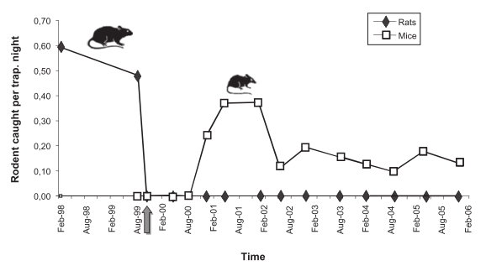
Competitor release
Target species reduction (e.g pest control)
Mesopredator 2
Mesopredator 1
Secondary species increases
Caut et al. (2007). Rats dying for mice: Modeling the competitor release effect
Notes:
Caut et al 2007:
Showed with a two species competing model that control of one species lead to the increase of the other species. And counter intuitively the stronger the removal the stronger the response from other species.
Quite often the case with 1080 because gets rats but not mice. Invertibrate community structure???

Slide 24


Mesopredator release
Superpredator
Secondary species increases (“mesopredator release”)
Target species reduction (e.g pest control)
Mesopredator
Prey
Soule et al. (1988). Reconstructed dynamics of rapid extinctions of chaparral-requiring birds in urban habitat islands
Notes:
Funny to reference this paper for this.
Huge amount of lit. on this.
Explained at the beginning.
Can u explain it???????

Slide 25


Hyperpredator release
Superpredator
Target species reduction (e.g pest control)
Secondary species increases (“surprise effect”)
Herbivore
Mesopredator 2
Courchamp et al. (2000). Rabbits killing birds: modeling the hyperpredation process
Notes:
Cats, rabbits and bird
More complex.
Cat can’t survive over winter.
Still working on the understanding of this personally

Slide 26
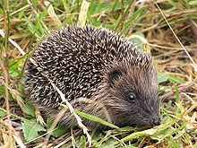
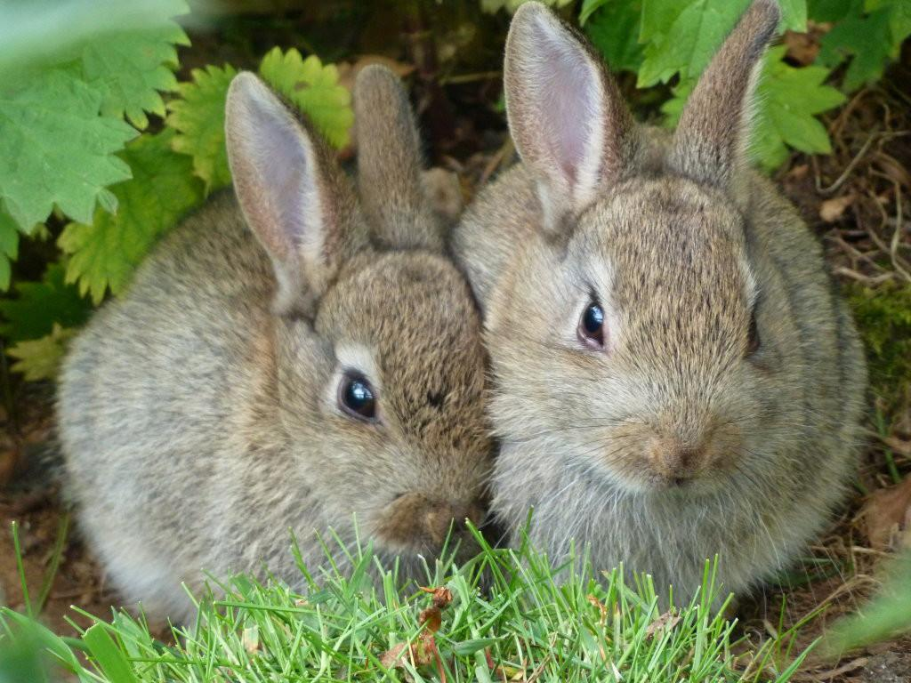
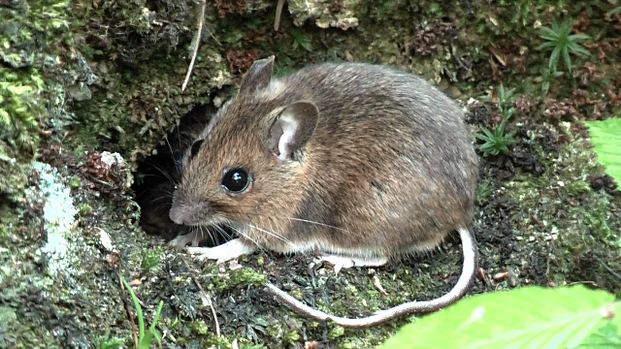
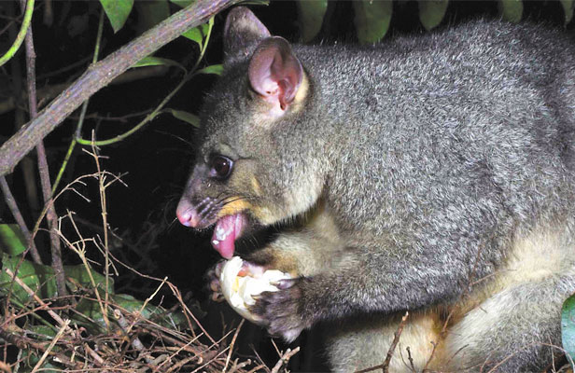
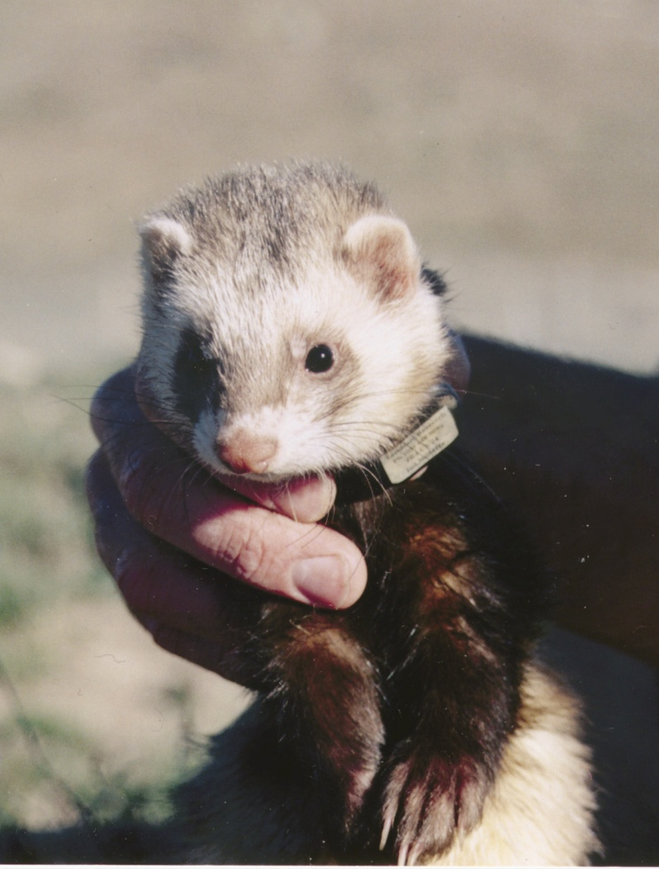
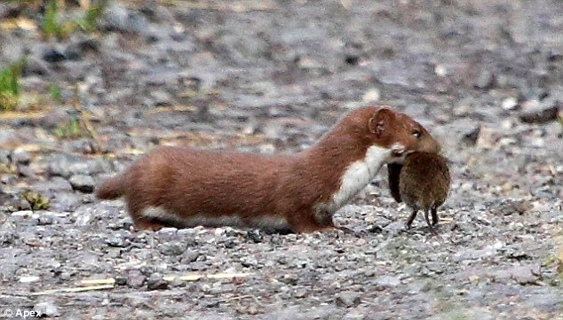
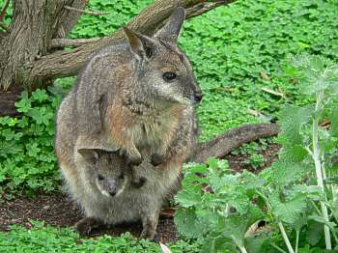
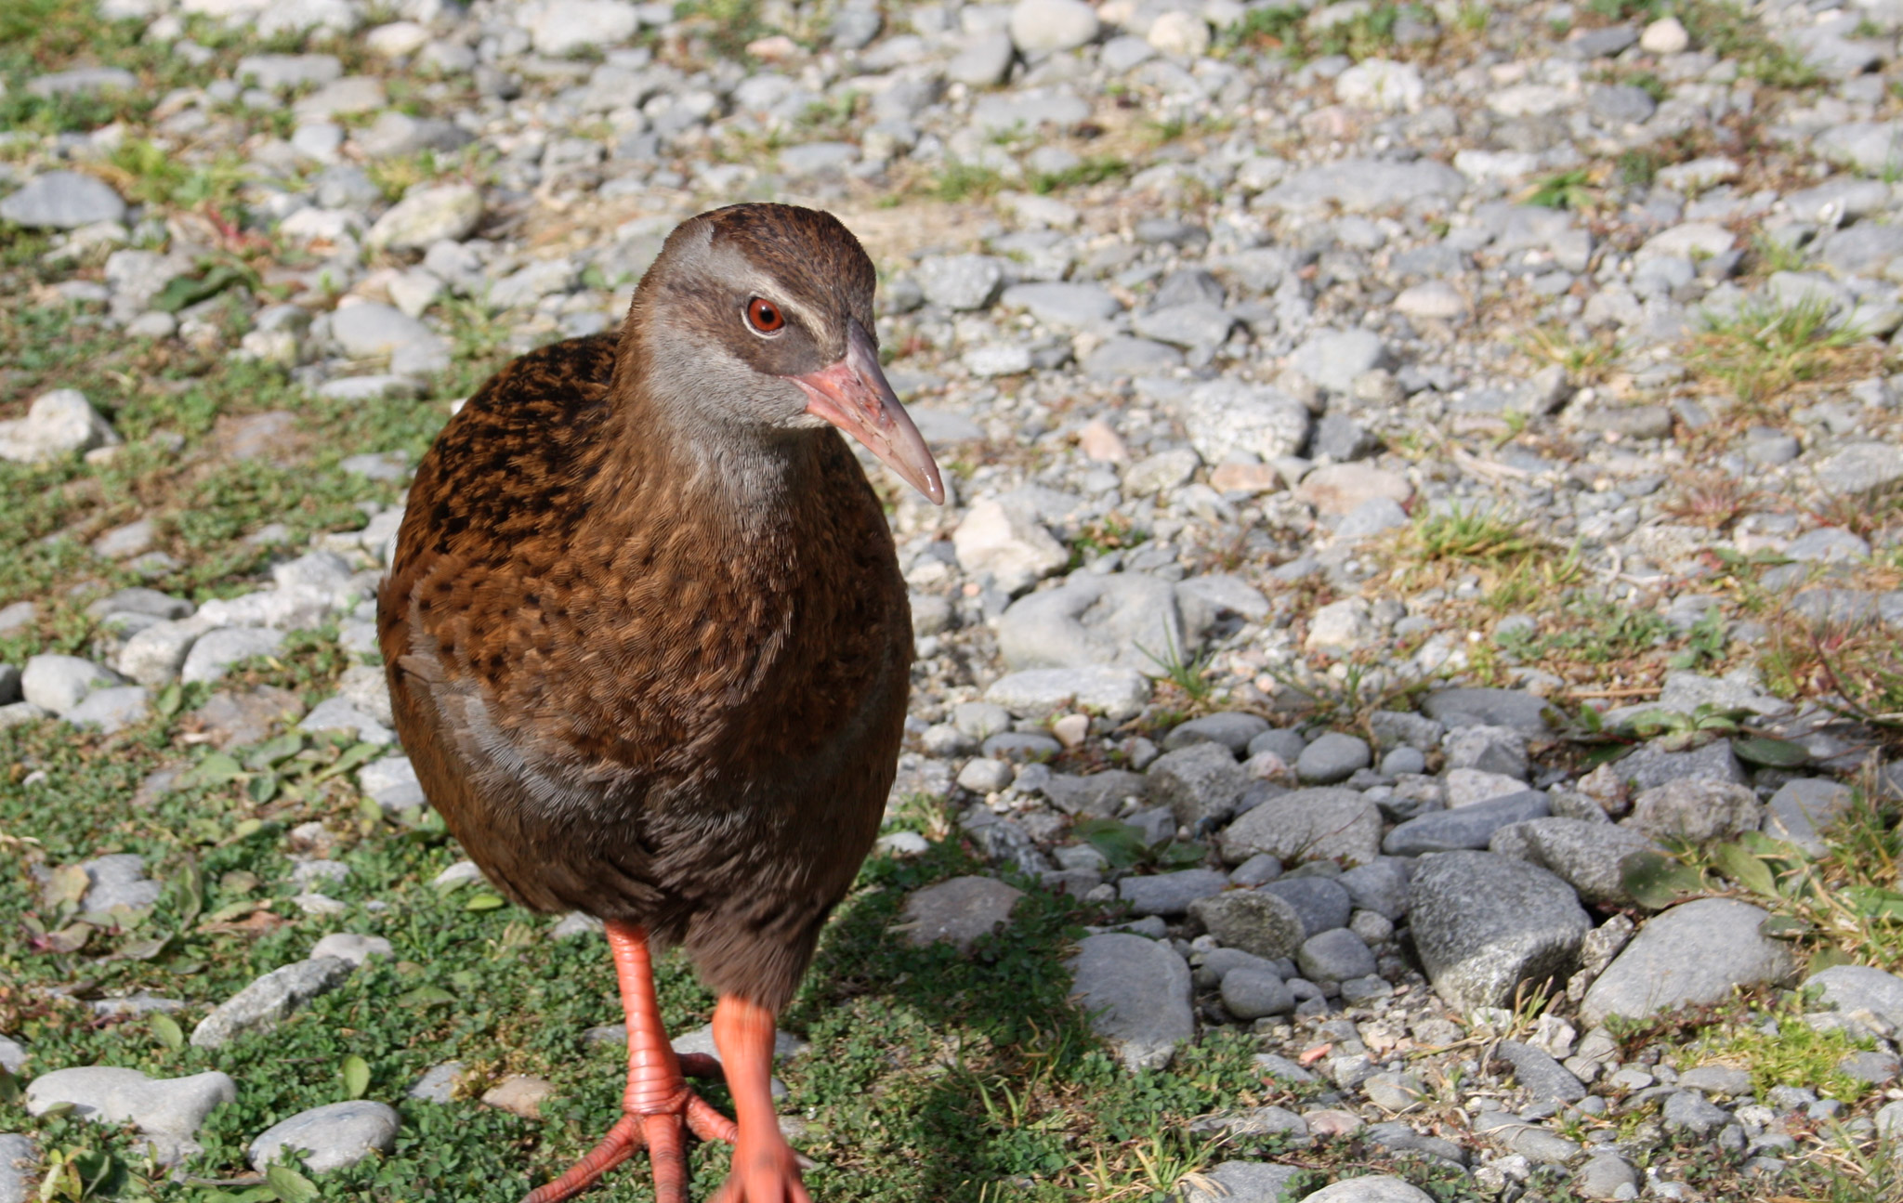
New Zealand pests
C M King
David Mudge
C M King
C M King
Notes:
Parkes and Murphy (2003) Management of introduced mammals in NZ
31 exotic mammals in NZ with confirmed wild or feral populations
Russell et al (2015) Predator-free NZ
105 pest free islands
76 run by community groups
There is a huge amongst of pest management being conducted and I don’t think they think about these things.

Slide 27
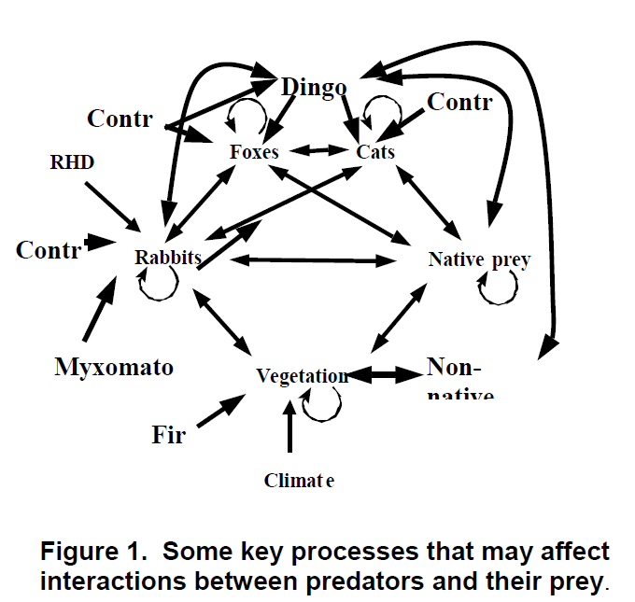
Complexities
Robley et al (2004). Interactions between feral cats, foxes, native carnivores, and rabbits in Australia. Final Report Australian Government
Notes:
From Australian species interactions.
Many of New Zealand's mainland systems are probably like this because introduced species are well established in the ecosystem.
Some previously adapted to this sort of environment (stoats, voles (front cover photo)

Slide 28
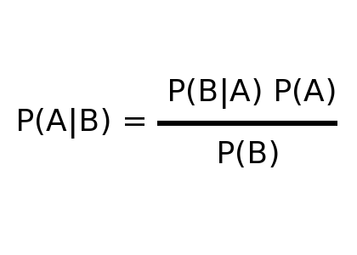
Bayesian inference
Data
Prior information
Bayes rule
Turn the crank approach (MCMC)
Posterior distributions
Expected values and variances

Slide 29
Hierarchical approach to modelling
Ecological mechanisms
S
S
S
Observation mechanisms

Slide 30
Linking data and theory
Ecological mechanisms:
Competition
Predation
Hyperpredation
Mesopredator release
Ecological mechanisms
Observational mechanisms:
Abundance (mark-recapture)
Detection
Presence/absence
Kill traps
Bird calling rates
S
S
S
Observation mechanisms

Slide 31
Simple as…
Model output comparable to theoretical models of “unexpected outcomes”
DATA
Bayesian hierarchical model
Notes:
Simple as bro

Slide 32
Chapter One
Simple Bayesian hierarchical model – Mice dynamics in Beech forest.
High quality mark-recapture data
Estimate the effect of stoats on mice dynamics
Two areas (control– uncontrolled stoats)
Hierarchical model

Slide 33
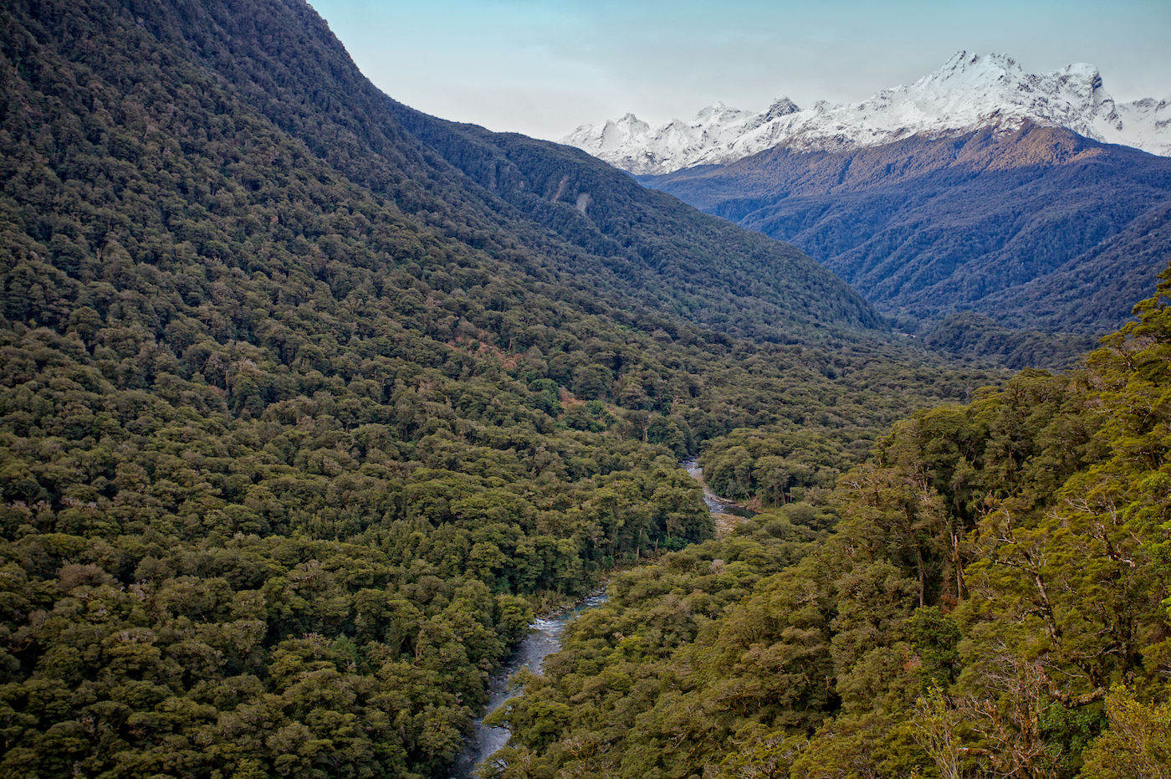
Case study one
©scribblesnz
Notes:
Hollyford valley
PhD aims:
Apply the Bayesian framework
Build mark-recapture models
Incorporate ecological process models (e.g. predator-prey dynamics) with observation models (e.g. mark-recapture) using Bayesian hierarchical modeling

Slide 34
Case study aims
Estimate rodent abundance using mark-recapture models
Combine mice, beech seed and rat data to directly estimate the predator prey dynamics
To estimate the effect of stoat control on mice dynamics in New Zealand beech forest

Slide 35
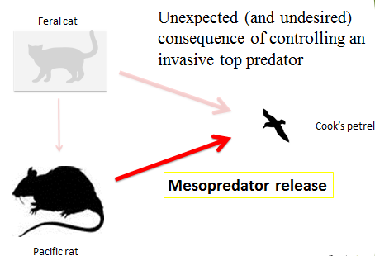
Hypothesis
Stoat removal will lead to mesopredator release of mice and rats
As observed on Little Barrier Island:

Slide 36
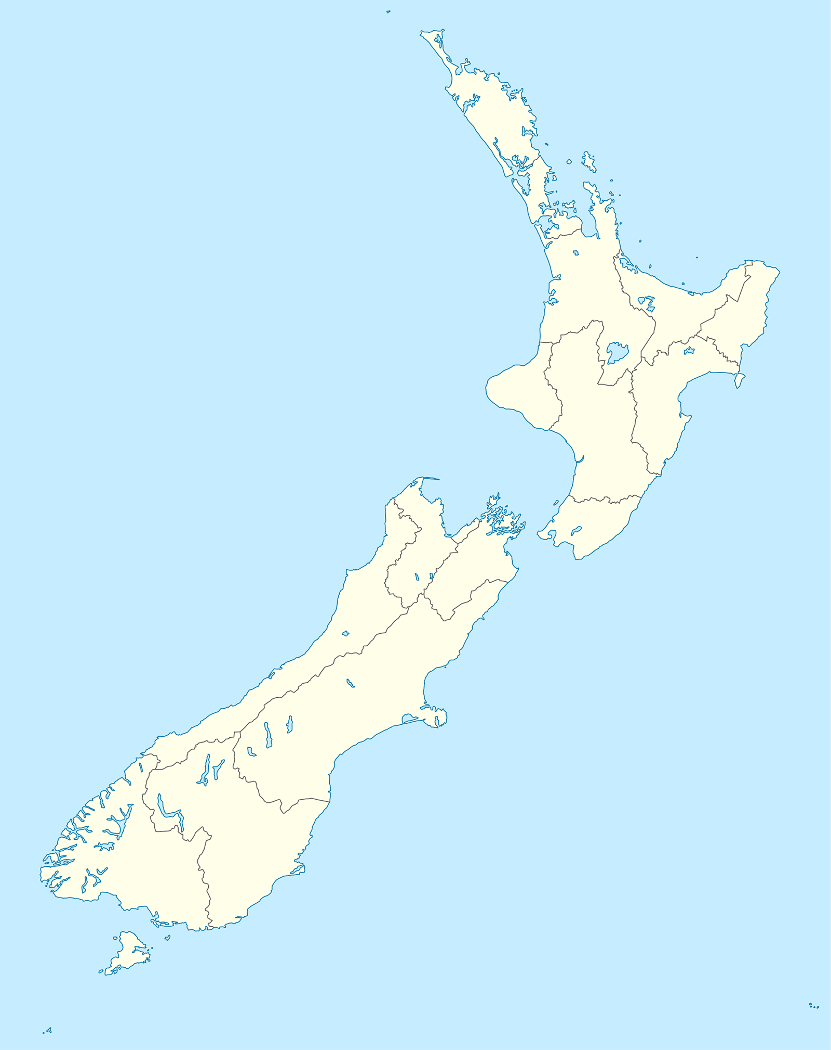
Location
Eglinton Valley
Hollyford valley
Southern beech forest (Nothafagus)
Application of stoat control in one valley but no the other

Slide 37
Study design
Hollyford Valley (No stoat control between 1999 and 2002)
Eglinton Valley (Stoats controlled throughout study)
May 1999 – November 2003
Data collection each quarter (February, May, August, November)
Notes:
Data structure:
2 ecosystems
6 grids
81 traps per grids
5 nights trapping
20 quarters (May 1993-November 1993)

Slide 38
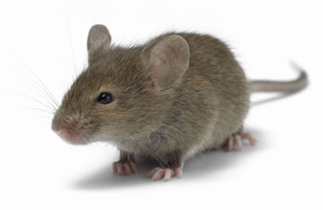
Diagram of study design
Eglinton
Hollyford
6x GRID
6x GRID
http://cdn.domyownpestcontrol.com/images/content/house_mouse.jpg
Sampling structure:
5 nights trapping
20 quarters (May 1993 - November 1993)
2 valleys
12 grids
81 traps (9*9 grid, 20m apart)
81 x TRAPS
81 x TRAPS
81 x TRAPS
81 x TRAPS
81 x TRAPS
81 x TRAPS
81 x TRAPS
81 x TRAPS
Variables collected:
CR mice
CR rats
CR kiore
Seed trap data
Presence/Absence stoats
Various other proxies
81 x TRAPS
81 x TRAPS
81 x TRAPS
81 x TRAPS

Slide 39
The beginning of the process model
Stoats
Mice
Rats
Beech forest flower & seed
Environment
Notes:
Each one of these arrows describes a different process.
Each one of these processes are linked through a series of relationships
Based on the literature this model is the full model and we can now build this up and using bayesian modelling to incorperate process and observation variation?

Slide 40
Process model
Stoats
Mice
Rats
Beech forest flower & seed
Notes:
Looks complex…depends what the relationships are

Slide 41
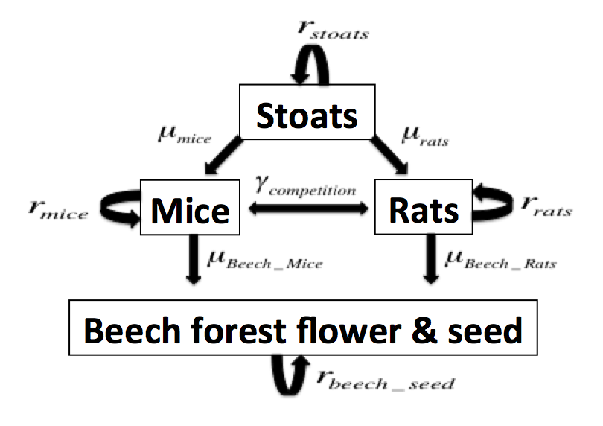
Breaking down the process model 1
Four components
1 predator (stoats)
2 mesopredators (rats and mice)
1 resource (beech seed)

Slide 42
An observation model
0 | 0 | 0 | 1 | 1
1 | 0 | 1 | 0 | 0
1 | 0 | 0 | 0 | 1
0 | 1 | 0 | 1 | 0
Mice estimates are capture-recapture data (CR).
Estimate for my process model is growth rate (r_stoats)
Range of possible modeling choices
Issues with recapture probability
Notes:
Well studied technique
Used for all sorts of species
Southern right whales
Type of models
Robust design
Superpopulation
CJS
Types of data
Closed
Open
Short study/lonmg study
Many days in row
Different life history traits

Slide 43
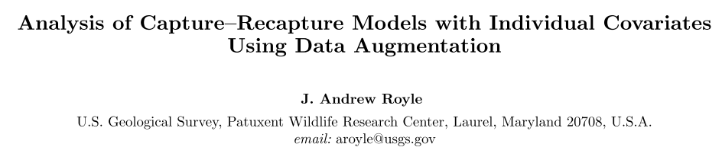
Capture-recapture models using data augmentation
Bayesian
Two step model
Adds zero’s for the unobserved but present animals
Capture probability can include co-variates (sex, size etc.).
Notes:
Model
Write Rjags code
Investigated data augmentation

Slide 44
Chapter Two: Aims/Hypothesis
The removal of possums will cause mesopredator release of rodents (mice and rats)
The removal of possums will cause a reduction in prey species (birds and invertebrates)
Notes:
Mixed podocarp forest (interactions between possums, birds, rats, mice and stoats)

Slide 45
Chapter Three: Aims/Hypothesis
It is possible to produce estimates of interspecies interactions using five-minute bird counts
The type/timing of 1080 application increases biodiversity outcomes
Identify which species persist through time under the presence of pests
Notes:
Different measurement index’s (Kill data, Different studies conducted at the same time)

Slide 46
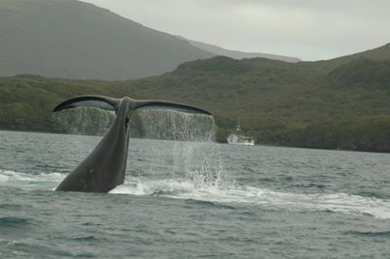
Thanks for your time Questions?

Slide 47
References
Caut, S., Angulo, E., & Courchamp, F. (2009). Avoiding surprise effects on Surprise Island: Alien species control in a multitrophic level perspective. Biological Invasions, 11(7), 1689–1703. http://doi.org/10.1007/s10530-008-9397-9
Choquenot, D., & Ruscoe, W. A. (2000). Mouse population eruptions in New Zealand forests: the role of population density and seedfall. Journal of Animal Ecology, 69, 1058–1070.
Courchamp, F., Chapuis, J.-L., & Pascal, M. (2003). Mammal invaders on islands: impact, control and control impact. Biological Reviews, 78(3), 347–383. http://doi.org/10.1017/S1464793102006061
Courchamp, F., Langlais, M., & Sugihara, G. (2000). Rabbits killing birds: Modelling the hyperpredation process. Journal of Animal Ecology, 69(1), 154–164. http://doi.org/10.1046/j.1365-2656.2000.00383.x
Holland, E. P., James, A., Ruscoe, W. A., Pech, R. P., Byrom, A. E., & Byrom, E. (2015). Climate-based models for pulsed resources improve predictability of consumer population dynamics: outbreaks of house mice in forest ecosystems. PloS One, 1–16. http://doi.org/10.1371/journal.pone.0119139
Rayner, M. J., Hauber, M. E., Imber, M. J., Stamp, R. K., & Clout, M. N. (2007). Spatial heterogeneity of mesopredator release within an oceanic island system. Proceedings of the National Academy of Sciences of the United States of America, 104(52), 20862–20865. http://doi.org/10.1073/pnas.0707414105
Robley, A., Reddiex, B., Arthur, T., Pech, R. P., & Forsyth, D. (2004). Interactions between feral cats, foxes, native carnivores, and rabbits in Australia. Final report for the Australian Government Department of the Environment and Heritage, Canberra. Interactions, (September), 72.
Royle, A. J. (2009). Analysis of capture-recapture models with individual covariates using data augmentation. Biometrics, 65, 267–274. http://doi.org/10.1111/j.1541-0420.2008.01038.x
Ruscoe, W. A., Elkinton, J. S., Choquenot, D., & Allen, R. B. (2005). Predation of beech seed by mice: effects of numerical and functional responses. Journal of Animal Ecology, 74, 1005–1019. http://doi.org/10.1111/j.1365-2656.2005.00998.x
Ruscoe, W. A., Ramsey, D. S. L., Pech, R. P., Sweetapple, P. J., Yockney, I., Barron, M. C., … Duncan, R. P. (2011). Unexpected consequences of control: competitive vs . predator release in a four-species assemblage of invasive mammals. Ecological Letters, 14, 1035–1042. http://doi.org/10.1111/j.1461-0248.2011.01673.x

Slide 48
Surprise effects on Surprise Island
Caut et al. (2007) Avoiding surprise effects on Surprise Island: alien species control in a multi-trophic level prospective
The perfect ecological study (pre-analysis, experiment, post analysis)
Surprise effects are the unexpected and undesirable outcomes based on chain reactions
e.g.
Pest control for cats on Macquarie Island and rabbits increase
Pest control for pigs on Sarigan Island resulted in a population explosion of an exotic vine
Notes:
Caut et al 2007 NOTES:
Eradications are successful generally
But unexpected and unwanted consequences occur (surprise effects)
Not monitored on an ecosystem level
This study:
Show the role of ship rats on a tropical pacific atom (New Caledonia)
Pre, during and post experiments
Practical application of surprise effects
Methods:
Pick an Island (give enivromental attributes)
Pre-eradication study:
Plant communities
Animal communities
Rat impacts (ecology and feeding)
Eradication
Post-eradication study
Rat abundance
Plants and animals re-sampled using same protocol as pre-study
Results:
Success and no surprise effects
Discussion:
Very small Island
Good vegetation studies
Luxury to have pre/post work (4 year study)
What about now? Only on post-study
Trade-off between research and management

